Slide 1


Slide 2



Desalination project
Aariana Griffin, Emily Lewis, Esther Kwon, Diya Patel

Slide 3
Overview
Our desalination idea is reasonably priced and resourceful. Using the power or the tides, water can flow into a rectangular contraption lined with reverse-osmosis filters. Then the tides can lower, collecting filtered water. The water can then be used in many different ways. This filter can clean itself and requires less maintenance than mechanisms in the status quo.

Slide 4

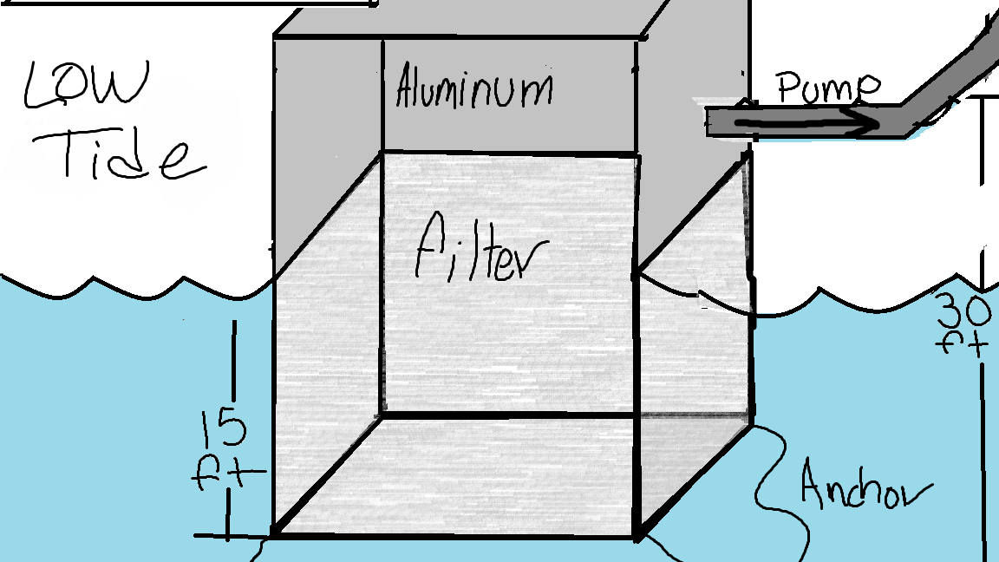
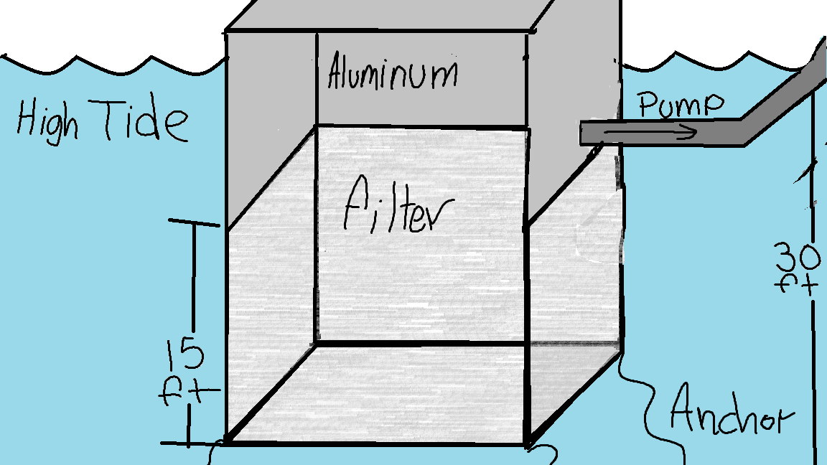
Diagram

Slide 5
Materials/Cost
Aluminum (1 panel)- $50-150
Nails (1 lb. pack)- $3-12
Desalination Filter- $60-9000
Pipes (plastic or rubber)- $10-20

Slide 6
Related Ideas/Inventions

Slide 7
How It Works (in detail)
The machine works in a very simple sense. It is placed in a way so that when the tide is at its lowest point for the year it will be 15 feet under the water. It is placed 15 feet under because that is the minimum pressure required for reverse omisis filters to fliter the water lfbfxmcnvbmxcnbvskiudfhlwie flwkhfgsbjdgfkushdrfnksducfhksduyf skdjcasdjkgcasi ukfjhidsucfhqskjdficyaskhfckajsFHC DUWTwcfouc ; wef wshfawer

